Slide 1
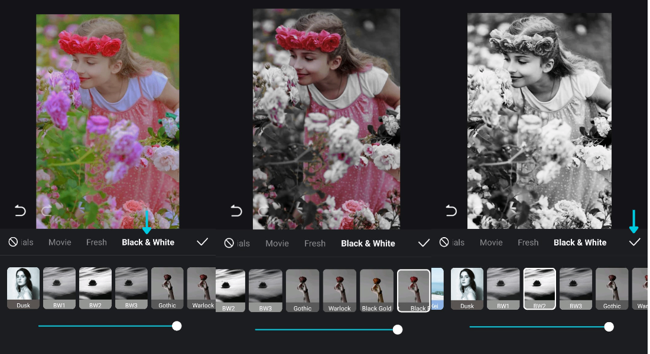

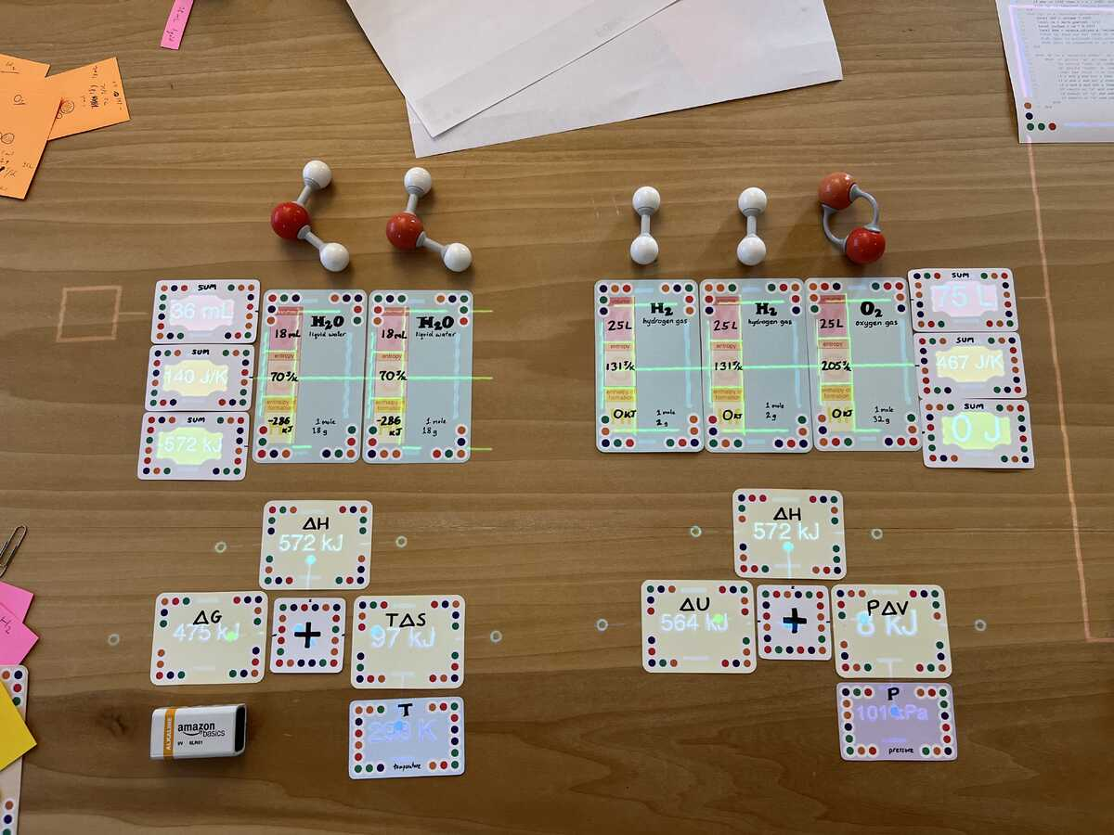
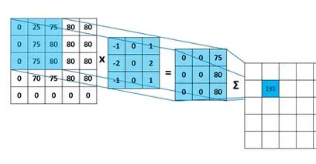

Virtuareal
Jade Chang & Junxiong Chen
Inspiration
Problem
A modularized programming and interactive table designed by Dynamicland
Applying filters on pictures is not enough customized and cannot reflect my great knowledge in Signal Processing
More customization!
More WILDNESS!
idea
Let’s make an interactive table that does 2D-kernel convolutions and other processing skills to customize our picture filters!
I can help you
DO IT YOURSELF!

Slide 2
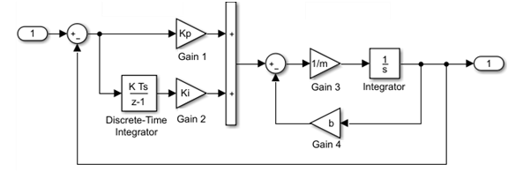
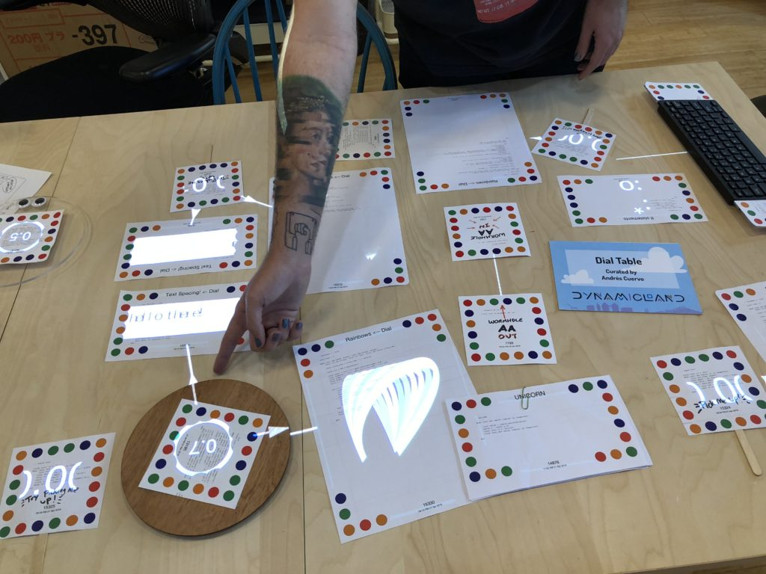
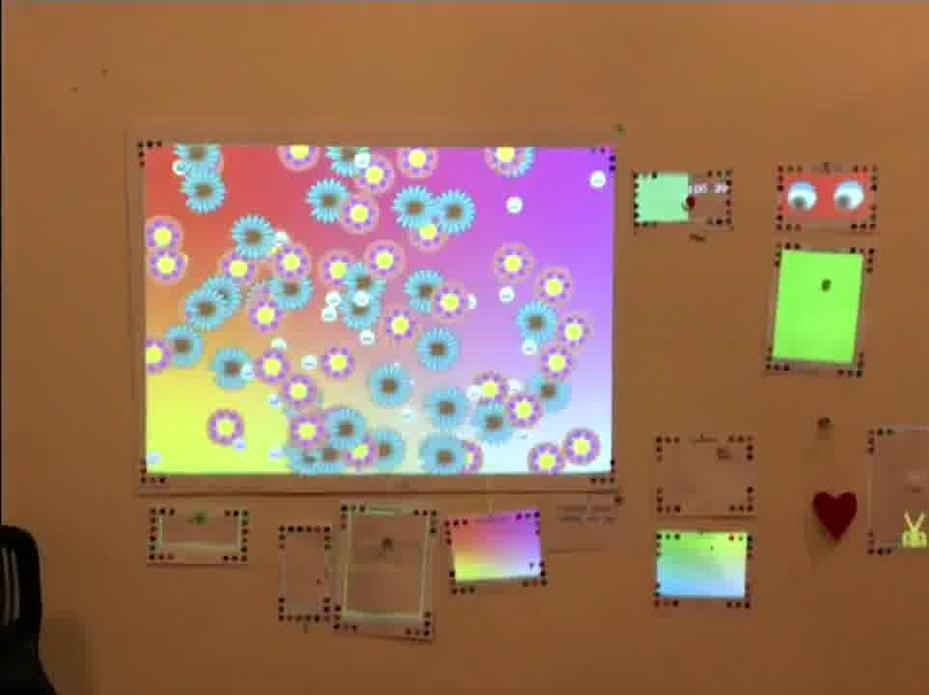
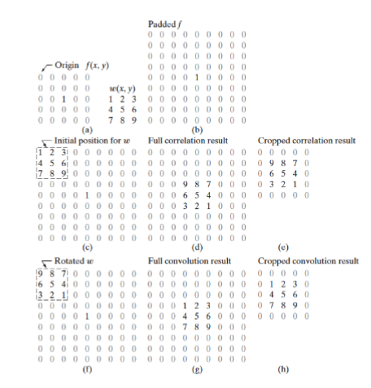
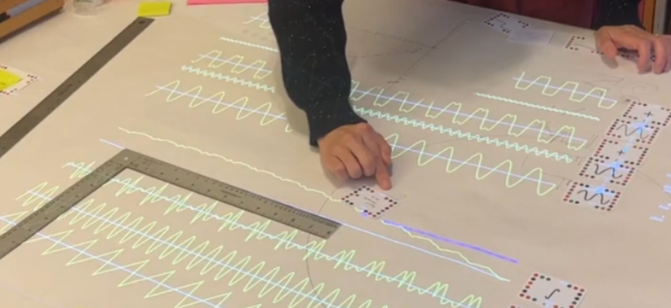
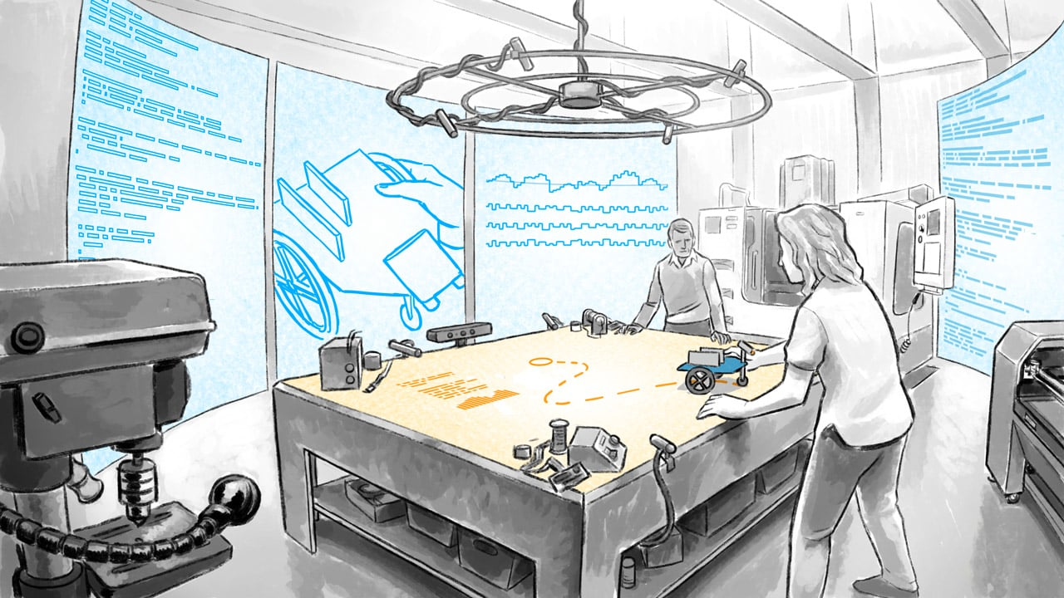
Virtuareal
Jade Chang & Junxiong Chen
idea
metaphor
model
display
picture→filter→picture
BUT do with cards
In REAL WORLD!!!
Build your system
like Simulink
Self-funded projector (;n;)
error
scenario
task
control
Not my bad!
Kids not knowing 2D-kernel convolution, drawing random stuffs
Draw cards and arrange them freely to DIY your own pipeline!
Do computer work away from computer
Filter pictures!

